Slide 1
Computer Vision
Part 1: Recurrent Neural Network
ADF – Start 08:30

Slide 2

Agenda
Part 1: Recurrent Neural Network
Part 2: Image Captioning
Computer Vision

Slide 3
Recurrent Neural Networks
Computer Vision

Slide 4
Sequence Data
In real world, lots of data are sequential
Audio data
Text data
Video data
Time series data
Computer Vision

Slide 5
Sequence in Neural Network
Many cases, for example with text data, we faced with uncertain amount of input
Input length (number of attributes) can vary
Vanilla Neural Network has a deterministic input size
can not directly handle it
Computer Vision

Slide 6
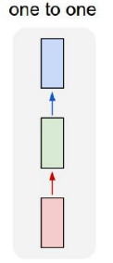
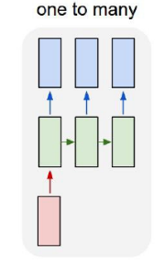
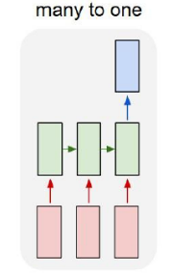
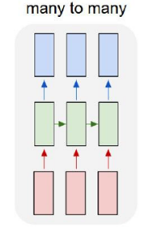
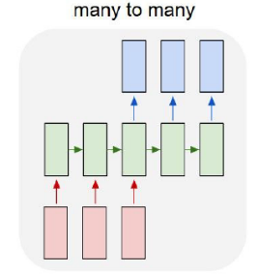
Recurrent Neural Networks
Vanilla Neural Networks
e.g. Sentiment Classification
sequence of words → sentiment
e.g. Machine Translation
seq of words → seq of words
e.g. Image Captioning
image → sequence of words
e.g. Video classification on frame level
Computer Vision

Slide 7
Recurrent Neural Networks
Use their internal state (memory) to process sequences of inputs.
While vanilla neural net performs mapping
Offer much flexibility in terms of input and output number
Contrast to vanilla neural net
Model size not increasing with size of input
Can solve much more general problems
Computer Vision

Slide 8
Recurrent Neural Networks
Elman Network
Jordan Network
Hopfield Network
Bi-directional Network
Long Shirt-term Memory
Gated Recurrent Unit
Etc.
Computer Vision

Slide 9
Recurrent Neural Network for Non-Sequential Data
Computer Vision

Slide 10
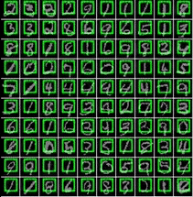
Sequential Processing of Non-Sequential Data
Classify images by taking a series of “glimpses”
Ba, Mnih, and Kavukcuoglu, “Multiple Object Recognition with Visual Attention”, ICLR 2015.
Gregor et al, “DRAW: A Recurrent Neural Network For Image Generation”, ICML 2015
Computer Vision

Slide 11
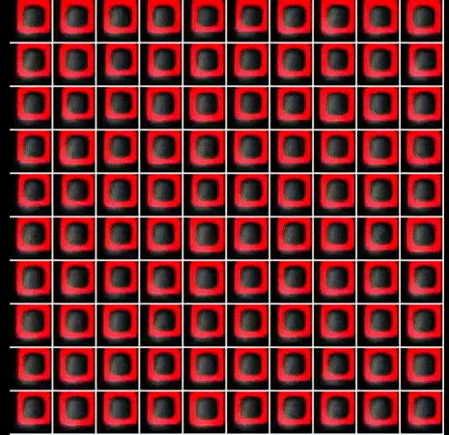
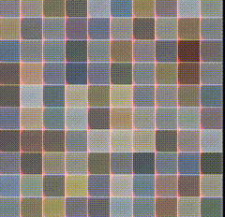
Sequential Processing of Non-Sequential Data
Generate images one piece at a time
Gregor et al, “DRAW: A Recurrent Neural Network For Image Generation”, ICML 2015
Computer Vision

Slide 12
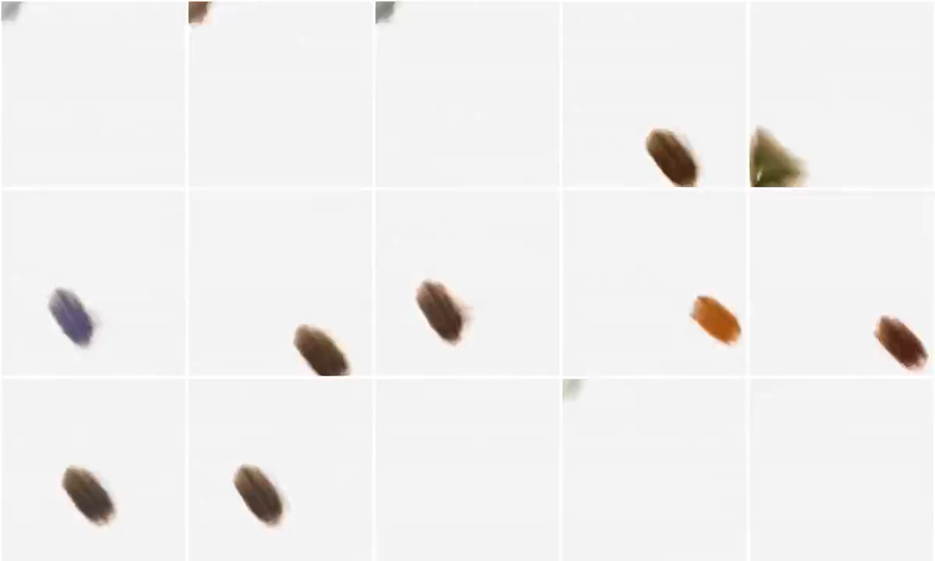
Sequential Processing of Non-Sequential Data
Integrate with oil paint simulator
At each timestep output a new stroke
Ganin et al, “Synthesizing Programs for Images using Reinforced Adversarial Learning”, ICML 2018
Computer Vision

Slide 13
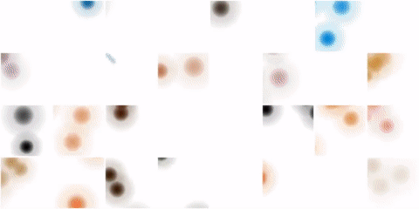

Sequential Processing of Non-Sequential Data
Integrate with oil paint simulator
At each timestep output a new stroke
Ganin et al, “Synthesizing Programs for Images using Reinforced Adversarial Learning”, ICML 2018
Computer Vision

Slide 14
Vanilla Recurrent Neural Network
Computer Vision

Slide 15
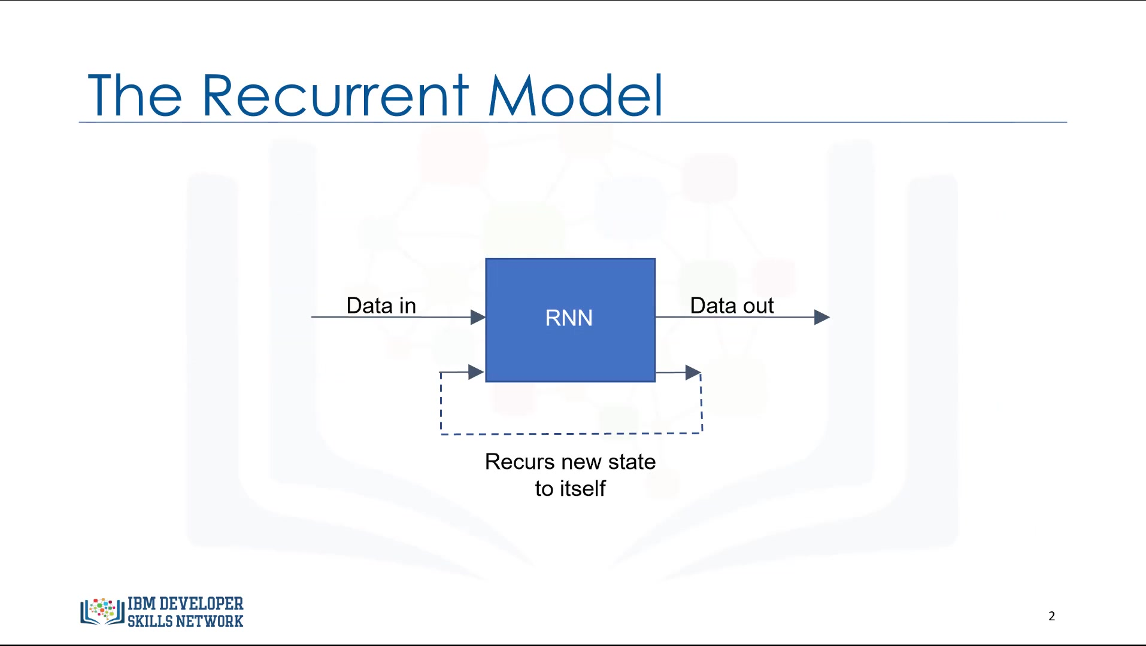
Recurrent Neural Network
RNN cell uses the state to record output at each stage that is passed.
State functions as a memory
The state is the inputted back into the cell, along with the next data in the sequence
Computer Vision

Slide 16
Recurrent Neural Network
Receive 2 inputs
Data Sequence
Previous state (hidden)
Produce 2 outputs:
Output Sequence (prediction)
Current State (hidden)
If there is an input for the next sequence, the current state will be used as the next input state
RNN
Data In
Data Out
previous hidden state
current hidden state
Computer Vision

Slide 17
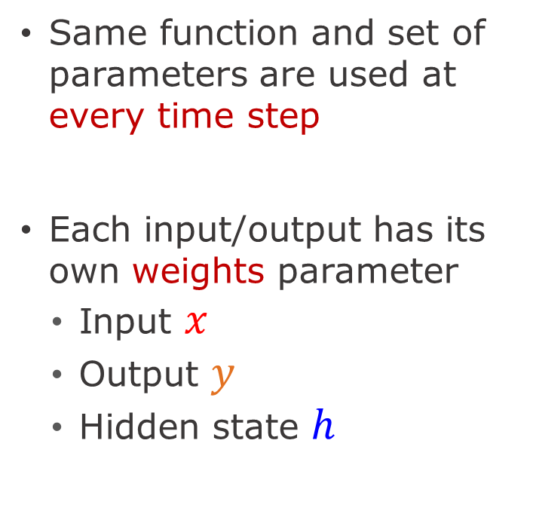
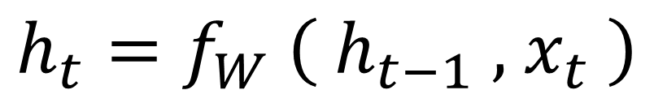
Recurrent Neural Network
Same function and set of parameters are used at every time step
Each input/output has its own weights parameter
Input $x$
Output $y$
Hidden state $h$
RNN
Data In
Data Out
previous hidden state
current hidden state
new state
old state
$$h_{t}=f_{W} \left( h_{t−1} , { x}_{t} \right)$$
Weight function
input at some time step
Computer Vision

Slide 18
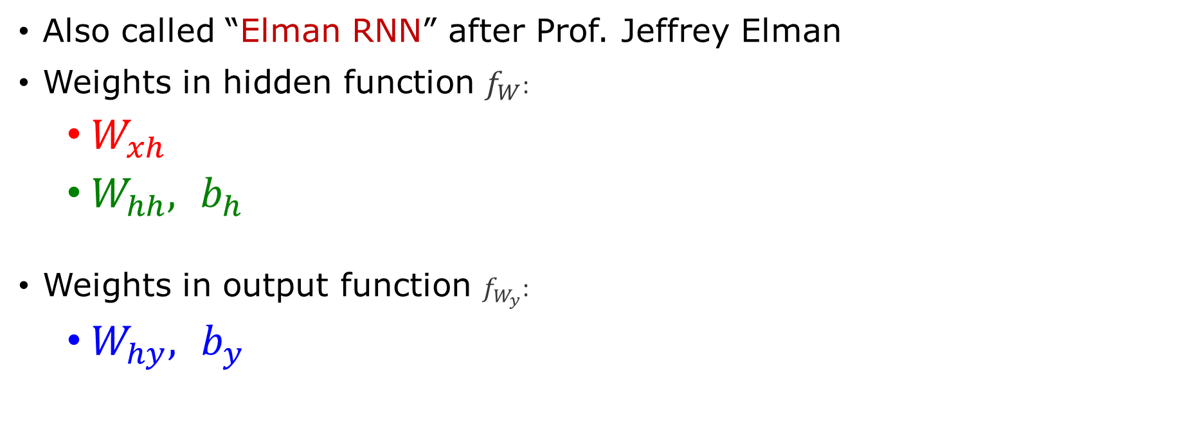
Vanilla Recurrent Neural Network
Also called “Elman RNN” after Prof. Jeffrey Elman
Weights in hidden function $f_{W}$:
$W_{xh}$
$W_{hh},$ $b_{h}$
Weights in output function $f_{W_{y}}$:
$W_{hy},$ $b_{y}$
Computer Vision

Slide 19
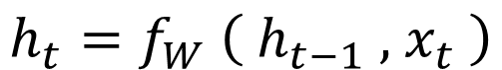
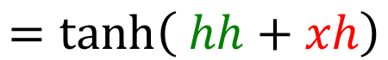
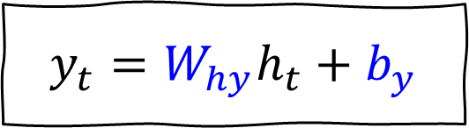
Vanilla Recurrent Neural Network
The state consists of a single "hidden" vector h
$$h_{t}=f_{W} \left( h_{t−1} , { x}_{t} \right)$$
$$=\tanh\left( hh+xh\right)$$
$$=\tanh\left(\left(W_{hh}h_{t−1}+b_{h}\right)+\left(W_{xh}x_{t}\right)\right)$$
$$y_{t}=W_{hy}h_{t}+b_{y}$$
Computer Vision

Slide 20
Recurrent Neural Networks Many to One Forward - Backward
Computer Vision

Slide 21
RNN Computational Graph
Re-use the same weight matrix at every time-step
W
W
h₀
f_{W}
h₁
f_{W}
h₂
f_{W}
h₃
h_{t}
. . .
x₁
x₂
x₃
“I”
“like”
“pizza”
Computer Vision

Slide 22
RNN : Many to One
Forward
loss
W
W
pred:
positive
y
W
h₀
f_{W}
h₁
f_{W}
h₂
f_{W}
h₃
h_{t}
. . .
x₁
x₂
x₃
“I”
“like”
“pizza”
Computer Vision

Slide 23
RNN : Many to One
Backward
Sum over all gradients to update weights
loss
W
W
y
W
W
W
dW
dW
dW
W
dW
dW
W
h₀
f_{W}
h₁
f_{W}
h₂
f_{W}
h₃
h_{t}
. . .
x₁
x₂
x₃
Computer Vision

Slide 24
Recurrent Neural Networks Many to Many Forward - Backward
Computer Vision

Slide 25
RNN : Many to Many
Forward
W
y₁
y₂
y₃
y_{t}
h₀
f_{W}
h₁
f_{W}
h₂
f_{W}
h₃
h_{t}
. . .
x₁
x₂
x₃
W
W
Computer Vision

Slide 26
RNN : Many to Many
Forward
Each timestep has its individual loss
W
L₁
L₂
L₃
L_{t}
y₁
y₂
y₃
y_{t}
h₀
f_{W}
h₁
f_{W}
h₂
f_{W}
h₃
h_{t}
. . .
x₁
x₂
x₃
W
Computer Vision

Slide 27
RNN : Many to Many
Sum losses for final scalar loss of the current training step
Forward
loss
W
L₁
L₂
L₃
L_{t}
y₁
y₂
y₃
y_{t}
h₀
f_{W}
h₁
f_{W}
h₂
f_{W}
h₃
h_{t}
. . .
x₁
x₂
x₃
W
Computer Vision

Slide 28
RNN : Many to Many
Backprop from total loss
Backward
loss
W
L₁
L₂
L₃
L_{t}
y₁
y₂
y₃
y_{t}
dW
dW
dW
dW
h₀
f_{W}
h₁
f_{W}
h₂
f_{W}
h₃
h_{t}
. . .
W
W
W
dW
dW
W
dW
dW
x₁
x₂
x₃
W
Computer Vision

Slide 29
RNN : Many to Many
Sum over all gradients to update weights
Backward
loss
W
L₁
L₂
L₃
L_{t}
y₁
y₂
y₃
y_{t}
dW
dW
dW
dW
h₀
f_{W}
h₁
f_{W}
h₂
f_{W}
h₃
h_{t}
. . .
W
W
W
dW
dW
W
dW
dW
x₁
x₂
x₃
W
W
Computer Vision

Slide 30
Recurrent Neural Networks One to Many Forward - Backward
Computer Vision

Slide 31
RNN : One to Many
Same Forward-Backward process
L₁
L₂
L₃
L_{t}
y₁
y₂
y₃
y_{t}
h₀
f_{W}
h₁
f_{W}
h₂
f_{W}
h₃
h_{t}
. . .
x₁
Computer Vision

Slide 32
Sequence to Sequence Many-to-One + One-to-Many
Computer Vision

Slide 33
Seq-to-Seq = Encoder-Decoder
Encoder: Many to One
Encode input sequence in a single vector
Build up the information
Decoder: One to Many
Decode vector into sequence
Rollback the information
Example: Machine Translation
Computer Vision

Slide 34
Sequence to Sequence
One to Many:
Decode vector into sequence
Many to One:
Encode input sequence in a single vector
y₁
y₂
h₀
f_{W1}
h₁
f_{W1}
h₂
f_{W1}
h₃
h_{t}
f_{W2}
h₁
f_{W2}
h₂
f_{W2}
. . .
. . .
x₁
x₂
x₃
W
W₂
W
W₁
Computer Vision

Slide 35
Character-level Language Model
Computer Vision

Slide 36
Language Modelling Problem
Understand and Produce Natural Language
Predict next word/character based on previous input sequence
Can be in Word-level or Character-level
Example
Build an RNN that can write word: h-e-l-l-o
Computer Vision

Slide 37
Language Modelling Setup
Goal: Build an RNN that can write word: h-e-l-l-o
Vocabulary: [h, e, l, o]
Convert (encode) into one-hot vector (dense vector)
1
0
0
0
0
1
0
0
0
0
1
0
0
0
0
1
"h"
"e"
"l"
"o"
Computer Vision

Slide 38
Training Data Setup
Character target (many-to-one):
Input: h-e-l Target: l
Input: e-l-l Target: o
…
Sequence target (many-to-many):
Input: h-e-l Target: e-l-l
Input: e-l-l Target: l-l-o
…
Computer Vision

Slide 39
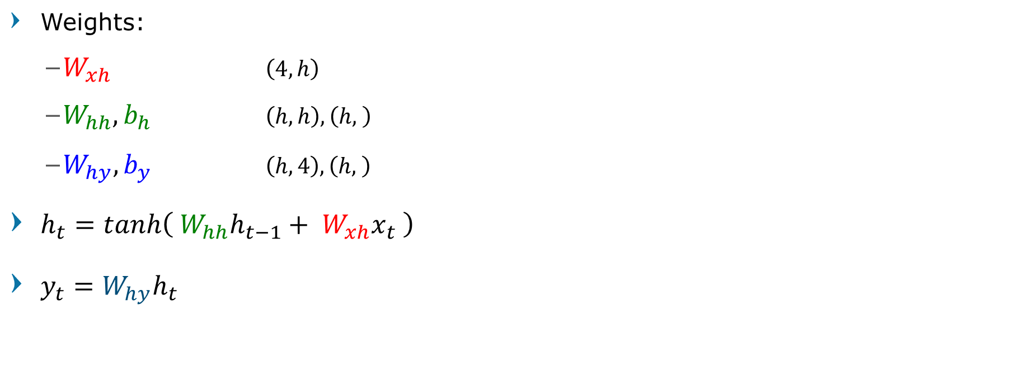
Character-level Language Model
Weights:
$W_{xh}$ $\left(4, h\right)$
$W_{hh}, b_{h}$ $\left(h, h\right), \left(h, \right)$
$W_{hy}, b_{y}$ $\left(h, 4\right), \left(h, \right)$
$h_{t}=tanh\left( W_{hh}h_{t−1}+ W_{xh}x_{t} \right)$
$y_{t}=W_{hy}h_{t}$
Computer Vision

Slide 40
Character-level Language Model Training
Computer Vision

Slide 41
Language Model Training
target chars
"e"
In the first timestep, input 'h' with target 'e' gets output 'o'. (wrongly classified)
1.0
2.2
-3.0
4.1
L₁
output layer
W_{hy}
Calculate loss in timestep 1
W_{hy}
0.3
-0.1
0.9
hidden layer
W_{xh}
W_{xh}
1
0
0
0
0
1
0
0
0
0
1
0
0
0
1
0
input layer
input chars
"h"
"e"
"l"
"l"
Computer Vision

Slide 42
Language Model Training
target chars
"e"
"l"
1.0
2.2
-3.0
4.1
0.5
0.3
-1.0
1.2
L₂
output layer
W_{hy}
W_{hy}
W_{hy}
0.3
-0.1
0.9
W_{hh}
1.0
0.3
0.1
Hidden layer receive previous state
hidden layer
W_{hh}
W_{xh}
W_{xh}
W_{xh}
1
0
0
0
0
1
0
0
0
0
1
0
0
0
1
0
input layer
input chars
"h"
"e"
"l"
"l"
Computer Vision

Slide 43
Language Model Training
target chars
"e"
"l"
"l"
"o"
Total Loss
1.0
2.2
-3.0
4.1
0.5
0.3
-1.0
1.2
0.1
0.5
1.9
-1.1
0.2
-1.5
-0.1
2.2
output layer
W_{hy}
0.3
-0.1
0.9
1.0
0.3
0.1
0.1
-0.5
-0.3
-0.3
0.9
0.7
hidden layer
W_{hh}
W_{xh}
1
0
0
0
0
1
0
0
0
0
1
0
0
0
1
0
input layer
input chars
"h"
"e"
"l"
"l"
Computer Vision

Slide 44
Character-level Language Model Testing
Computer Vision

Slide 45
Test Time
Start with input prefix (seed)
One character prefix
Forward pass using trained weights W_{xh} W_{hh} W_{hy}
First hidden input is zeros
Result score y
Convert score to probability distribution using softmax
Computer Vision

Slide 46
Test Time
Random sample to synthesize (predict) output character
Pass predicted character as input to the next timestep
Repeat process to synthesize next characters
Computer Vision

Slide 47
Test Time
Sample randomly
"e"
Sample random based on the distribution
.03
.84
.00
.13
softmax
Convert to Probability Distribution
1.0
4.1
-3.0
2.1
output layer
W_{hy}
0.3
-0.1
0.9
Forward Pass
hidden layer
W_{hh}
W_{xh}
1
0
0
0
0
1
0
0
input layer
Use as input for the next sequence
input prefix
"h"
"e"
Computer Vision

Slide 48
Test Time
Sample randomly
"e"
"l"
.03
.84
.00
.13
.25
.20
.50
.05
softmax
1.0
4.1
-3.0
2.1
0.5
0.3
1.2
0.9
output layer
W_{hy}
0.3
-0.1
0.9
1.0
0.3
0.1
W_{hh}
hidden layer
W_{xh}
1
0
0
0
0
1
0
0
0
0
1
0
input layer
input prefix
"h"
"e"
"l"
Computer Vision

Slide 49
Test Time
Sample randomly
"e"
"l"
"l"
"o"
.03
.84
.00
.13
.25
.20
.50
.05
.11
.17
.68
.03
.11
.02
.08
.79
softmax
1.0
4.1
-3.0
2.1
0.5
0.3
1.2
0.9
0.1
0.5
1.9
-1.1
0.2
-1.5
-0.1
2.2
output layer
W_{hy}
0.3
-0.1
0.9
1.0
0.3
0.1
0.1
-0.5
-0.3
-0.3
0.9
0.7
W_{hh}
hidden layer
W_{xh}
1
0
0
0
0
1
0
0
0
0
1
0
0
0
1
0
input layer
input prefix
"h"
"e"
"l"
"l"
Computer Vision

Slide 50
Character-level Language Modeling Result Examples
Computer Vision

Slide 51
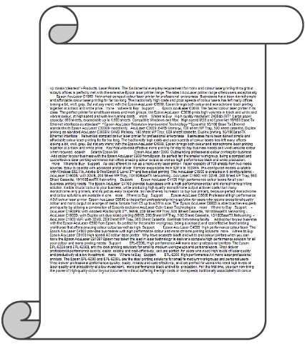
y
RNN
x
Computer Vision

Slide 52
Sonnet 116 – Let me not…
by William Shakespeare
Let me not to the marriage of true minds
Admit impediments. Love is not Love
Which alters when it alteration finds,
Or bends with the remover to remove:
It is the star to every wandering bark,
Whose worth's unknown although his height be taken.
Love's not Time's fool, though rosy lips and cheeks
Within his bending sickle's compass come:
But bears it out even to the edge of doom
If this be error upon me proved,
I never writ, nor no man ever loved.
Computer Vision

Slide 53
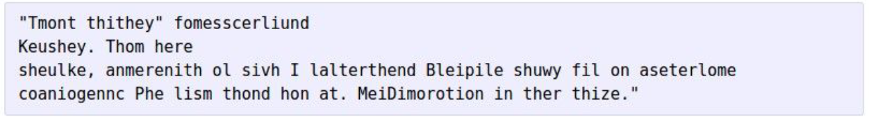
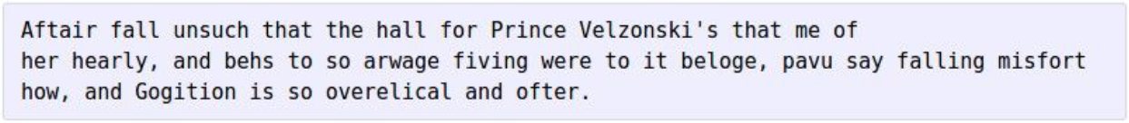
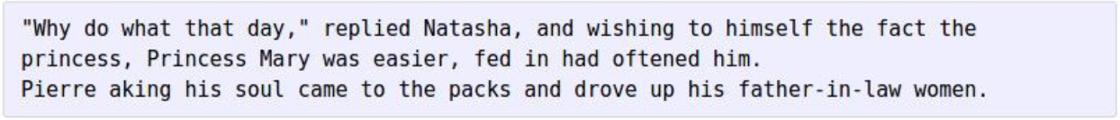
First iteration
Train more
Train more
Train more
Computer Vision

Slide 54
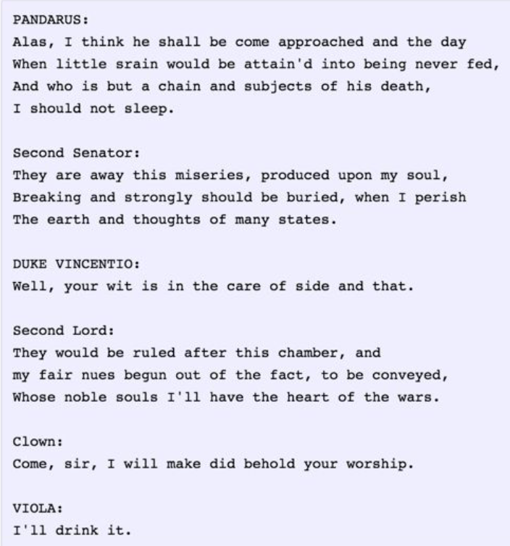
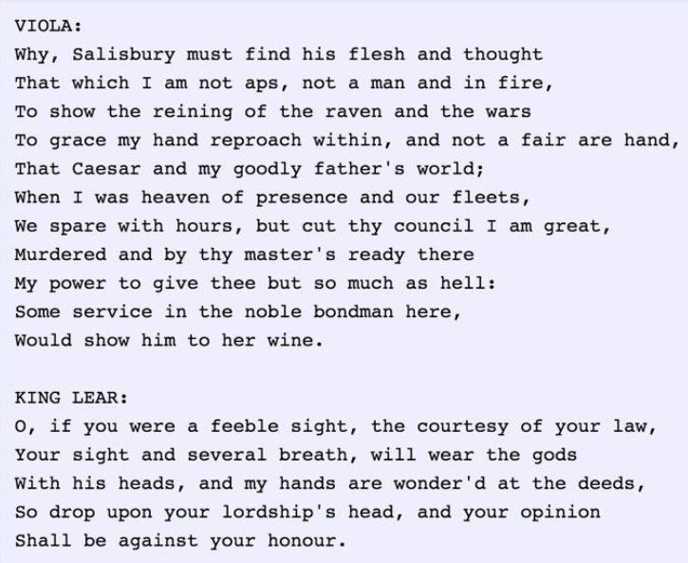
Computer Vision

Slide 55
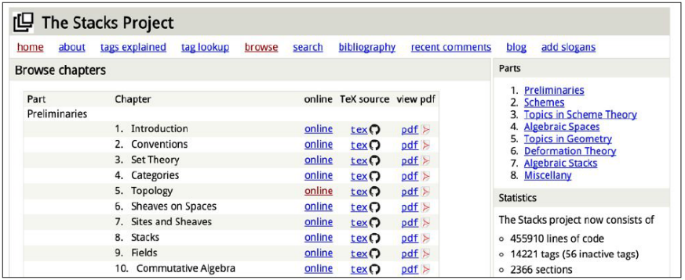
Generating Latex
open source textbook on algebraic geometry
Computer Vision

Slide 56
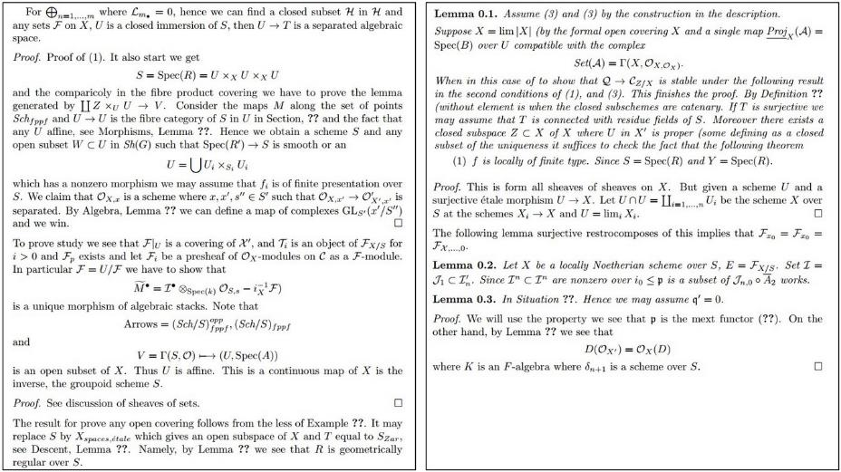
Computer Vision

Slide 57
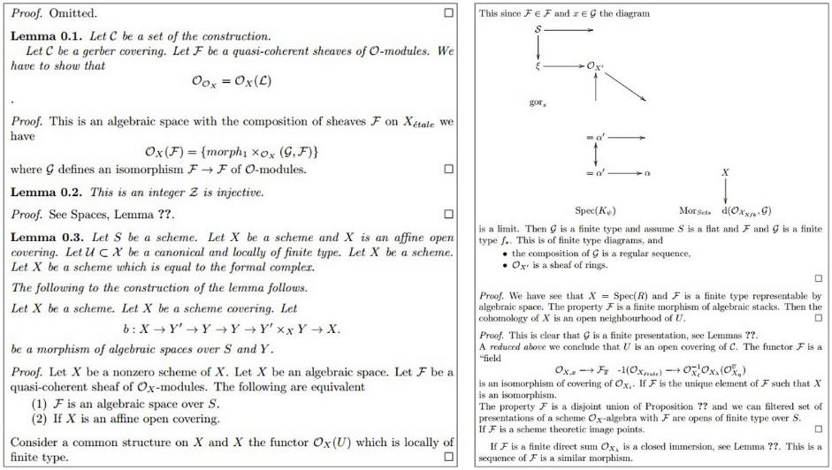
Computer Vision

Slide 58
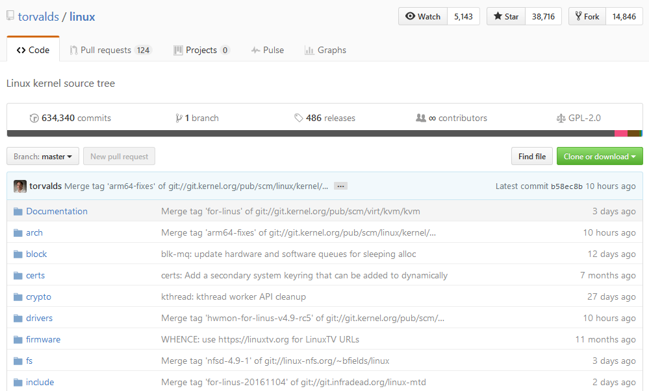
Computer Vision

Slide 59
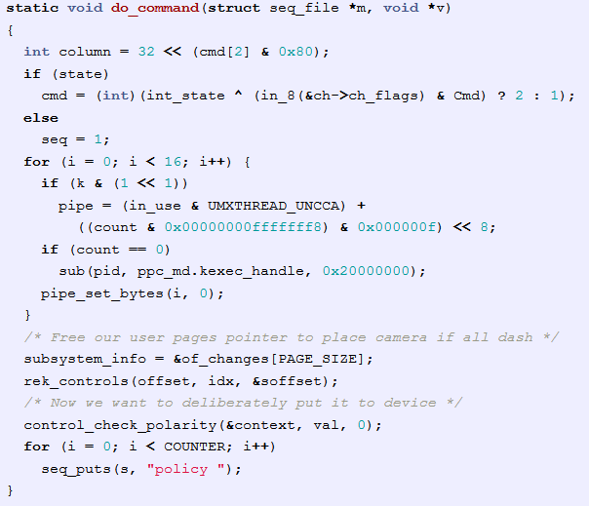
Generating C Code
Computer Vision

Slide 60
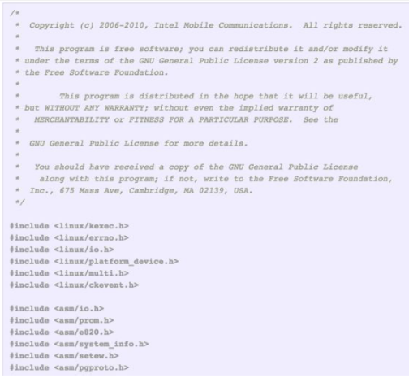
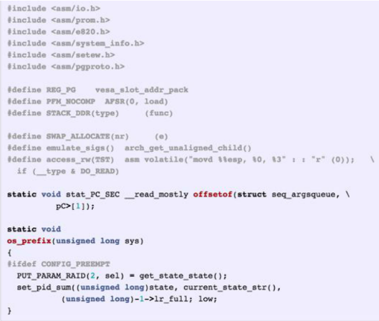
Computer Vision

Slide 61

Break, Question?
Computer Vision

Slide 62
RNN Problems
Computer Vision

Slide 63
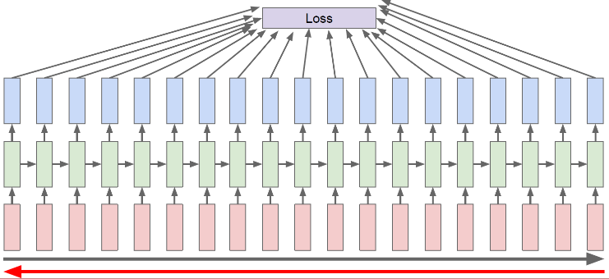
Backpropagation through time
Forward through entire sequence to compute loss,
then backward through entire sequence to compute gradient
Computer Vision

Slide 64
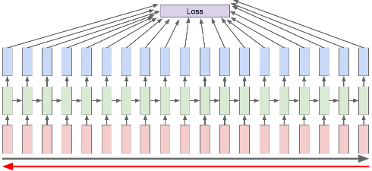
Backpropagation through time
Problem:
In long sequence training, training will be super slow
Had to forward pass through entire text,
Then backward pass through all gradient
And only compute single gradient update
Computer Vision

Slide 65
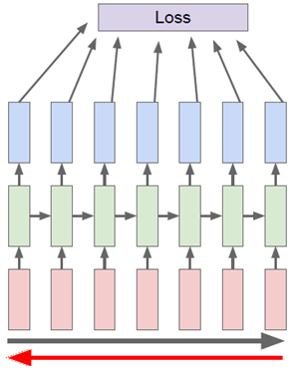
Truncated Backpropagation through time
Run forward and backward through chunks of the sequence instead of whole sequence
Computer Vision

Slide 66
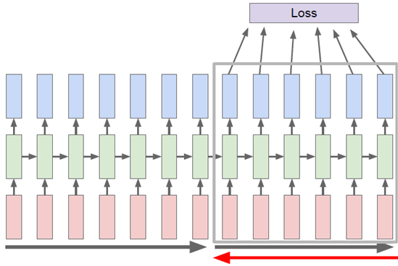
Truncated Backpropagation through time
Carry hidden states forward in time forever,
but only backpropagate for some smaller number of steps
Computer Vision

Slide 67
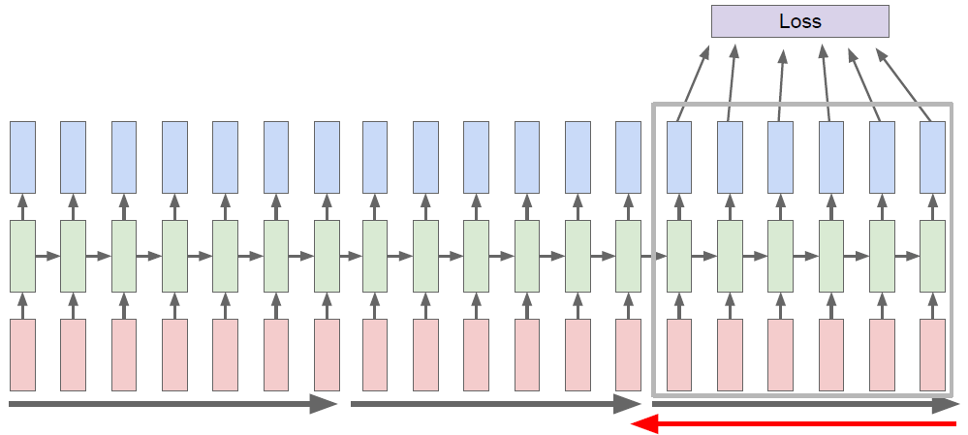
Truncated Backpropagation through time
Computer Vision

Slide 68
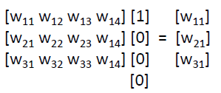
Word Embedding
"e"
"l"
"l"
"o"
One-hot vector just extract a column from input weight matrix
1.0
2.2
-3.0
4.1
0.5
0.3
-1.0
1.2
0.1
0.5
1.9
-1.1
0.2
-1.5
-0.1
2.2
output layer
W_{hy}
hidden layer
0.3
-0.1
0.9
1.0
0.3
0.1
0.1
-0.5
-0.3
-0.3
0.9
0.7
W_{hh}
W_{xh}
1
0
0
0
0
1
0
0
0
0
1
0
0
0
1
0
input layer
"h"
"e"
"l"
"l"
Computer Vision

Slide 69
Word Embedding
"e"
"l"
"l"
"o"
With large dictionary, the input vector will be just too huge
Need to perform some kind dimensionality reduction
Embedding
1.0
2.2
-3.0
4.1
0.5
0.3
-1.0
1.2
0.1
0.5
1.9
-1.1
0.2
-1.5
-0.1
2.2
output layer
W_{hy}
hidden layer
0.3
-0.1
0.9
1.0
0.3
0.1
0.1
-0.5
-0.3
-0.3
0.9
0.7
W_{hh}
W_{xh}
1
0
0
0
0
1
0
0
0
0
1
0
0
0
1
0
input layer
"h"
"e"
"l"
"l"
Computer Vision

Slide 70
Word Embedding
Unsupervised Training
Word2Vec, GloVe, Etc.
Embedding Layer
Train Embedding Weights on the fly
Resulting low-dimensional, Continuous Representation
usually ~50-300
Computer Vision

Slide 71
Training with Embedding
target chars
"e"
"l"
"l"
"o"
1.0
4.1
-3.0
2.1
0.5
0.3
1.2
0.9
0.1
0.5
1.9
-1.1
0.2
-1.5
-0.1
2.2
output layer
W_{hy}
0.3
-0.1
0.9
1.0
0.3
0.1
0.1
-0.5
-0.3
-0.3
0.9
0.7
W_{hh}
hidden layer
W_{eh}
embedding layer
.03
.84
.00
.13
.25
.20
.50
.05
.11
.17
.68
.03
.11
.02
.08
.79
W_{xe}
1
0
0
0
0
1
0
0
0
0
1
0
0
0
1
0
input layer
input prefix
"h"
"e"
"l"
"l"
Computer Vision

Slide 72
"Deep" Recurrent Neural Network
Computer Vision

Slide 73
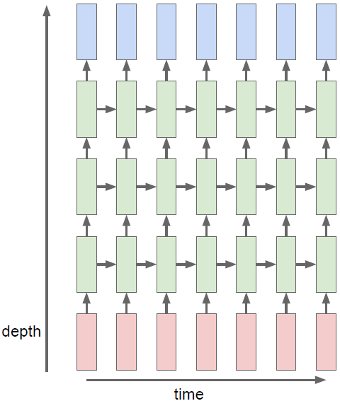
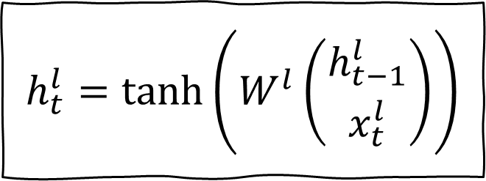
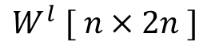
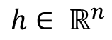
"Deep" Vanilla RNN
$$h_{t}^{l}=\tanh\left(W^{l}\left(\begin{matrix}h_{t−1}^{l} \\ x_{t}^{l}\end{matrix}\right)\right)$$
$$h∈ ℝ^{n}$$
$$W^{l} [ n×2n ]$$
Computer Vision

Slide 74
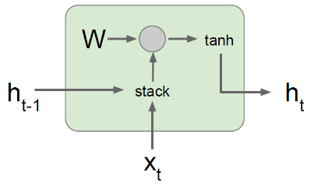
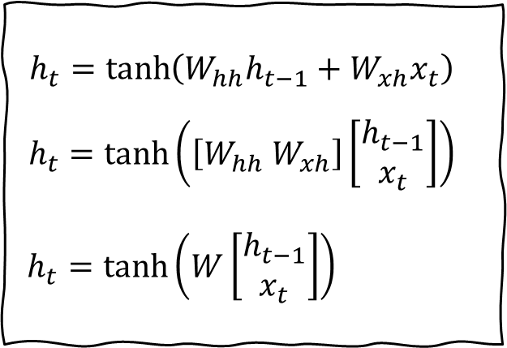
Problems with "Deep" Vanilla RNN
Vanilla RNN Gradient Flow
$$h_{t}=\tanh\left(W_{hh}h_{t−1}+W_{xh}x_{t}\right)$$
$$h_{t}=\tanh\left(\left[W_{hh} W_{xh}\right]\left[\begin{aligned}h_{t−1} \\ x_{t}\end{aligned}\right]\right)$$
$h_{t}=\tanh\left(W\left[\begin{aligned}h_{t−1} \\ x_{t}\end{aligned}\right]\right)$
Bengio et al, “Learning long-term dependencies with gradient descent
is difficult”, IEEE Transactions on Neural Networks, 1994
Pascanu et al, “On the difficulty of training recurrent neural networks”, ICML 2013
Computer Vision

Slide 75
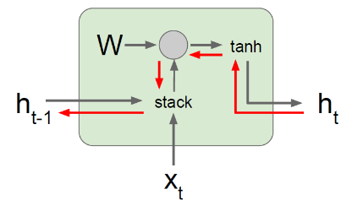
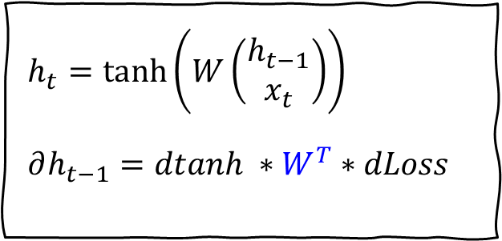
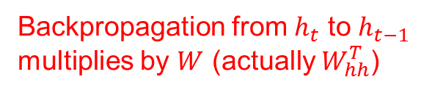
Problems with "Deep" Vanilla RNN
Backpropagation from $h_{t}$ to $h_{t−1}$ multiplies by $W$ (actually $W_{hh}^{T}$)
$h_{t}=\tanh\left(W\left(\begin{matrix}h_{t−1} \\ x_{t}\end{matrix}\right)\right)$
$$∂h_{t−1}=dtanh ∗W^{T}∗dLoss$$
Bengio et al, “Learning long-term dependencies with gradient descent
is difficult”, IEEE Transactions on Neural Networks, 1994
Pascanu et al, “On the difficulty of training recurrent neural networks”, ICML 2013
Computer Vision

Slide 76
RNN : Use the same weight matrix
loss
W
W
y
W
h₀
f_{W}
h₁
f_{W}
h₂
f_{W}
h₃
h_{t}
. . .
x₁
x₂
x₃
Computer Vision

Slide 77
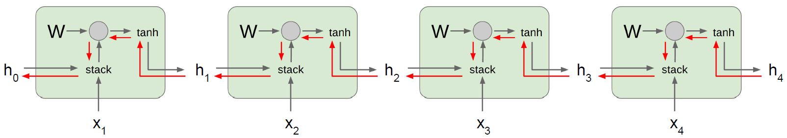
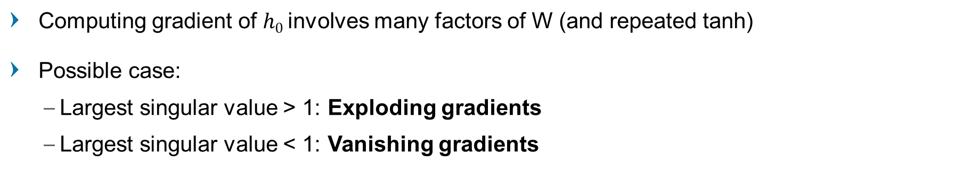
Problems with "Deep" Vanilla RNN
Computing gradient of $h0$ involves many factors of W (and repeated tanh)
Possible case:
Largest singular value > 1: Exploding gradients
Largest singular value < 1: Vanishing gradients
Computer Vision

Slide 78
Long Short-Term Memory
Computer Vision

Slide 79
Vanilla RNN LSTM
$$\left(\begin{aligned}\begin{matrix}i \\ f \\ o\end{matrix} \\ g\end{aligned}\right)=\left(\begin{aligned}sigm \\ sigm \\ sigm \\ tanh\end{aligned}\right)W^{l}\left(\begin{matrix}h_{t−1}^{l} \\ x_{t}^{l}\end{matrix}\right)$$
$$C_{t}^{l}=f⊙C_{t−1}^{l}+i⊙g$$
$$h_{t}^{l}=o⊙tanh⁡(c_{t}^{l})$$
$$h_{t}^{l}=\tanh\left(W^{l}\left(\begin{matrix}h_{t−1}^{l} \\ x_{t}^{l}\end{matrix}\right)\right)$$
$$h∈ ℝ^{n}$$
$$W^{l} [ n×2n ]$$
$$W^{l} [ 4n×2n ]$$
Hochreiter and Schmidhuber, “Long Short-Term Memory”, Neural Computation, 1997
Computer Vision

Slide 80
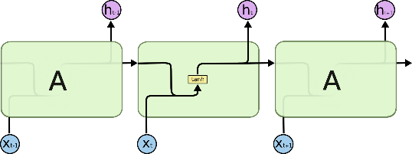

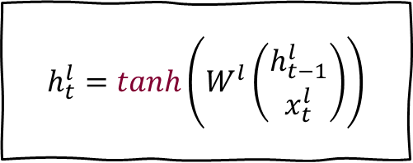

RNN
$$h_{t}^{l}=\tanh\left(W^{l}\left(\begin{matrix}h_{t−1}^{l} \\ x_{t}^{l}\end{matrix}\right)\right)$$
LSTM
$$\left(\begin{aligned}\begin{matrix}i \\ f \\ o\end{matrix} \\ g\end{aligned}\right)=\left(\begin{aligned}σ \\ σ \\ σ \\ tanh\end{aligned}\right) W^{l}\left(\begin{matrix}h_{t−1}^{l} \\ x_{t}^{l}\end{matrix}\right)$$
$$C_{t}^{l}=f⊙C_{t−1}^{l}+i⊙g$$
$$h_{t}^{l}=o⊙tanh⁡(c_{t}^{l})$$
Computer Vision

Slide 81
Long Short-Term Memory
4 gates (output from matmul-activation)
I : Input gate, whether to write to cell
F : Forget gate, whether to erase from cell
O : Output gate, How much to reveal from cell
G : Intermediate gate, How much to write to cell
Vanilla RNN just 1 gate
[Hochreiter et al., 1997]
Computer Vision

Slide 82

Long Short-Term Memory
vector from
below (x)
I : Input gate,
F : Forget gate,
O : Output gate,
G : Intermediate gate,
W
x
h
$$\left(\begin{aligned}\begin{matrix}i \\ f \\ o\end{matrix} \\ g\end{aligned}\right)=\left(\begin{aligned}σ \\ σ \\ σ \\ tanh\end{aligned}\right) W^{l}\left(\begin{matrix}h_{t−1}^{l} \\ x_{t}^{l}\end{matrix}\right)$$
$$C_{t}=f⊙C_{t−1}+i⊙g$$
$$h_{t}^{l}=o⊙tanh⁡(c_{t}^{l})$$
vector from
before (h)
[4h x 2h]
[4h x 1]
[Hochreiter et al., 1997]
Computer Vision

Slide 83
Long Short-Term Memory
Divide into 4 parts
I : Input gate,
F : Forget gate,
O : Output gate,
G : Intermediate gate,
W
x
sigmoid
i
h
sigmoid
f
$$\left(\begin{aligned}\begin{matrix}i \\ f \\ o\end{matrix} \\ g\end{aligned}\right)=\left(\begin{aligned}σ \\ σ \\ σ \\ tanh\end{aligned}\right) W^{l}\left(\begin{matrix}h_{t−1}^{l} \\ x_{t}^{l}\end{matrix}\right)$$
$$C_{t}=f⊙C_{t−1}+i⊙g$$
$$h_{t}^{l}=o⊙tanh⁡(c_{t}^{l})$$
vector from
before (h)
sigmoid
o
tanh
g
[4h x 2h]
[4h x 1]
4*[h x 1]
[Hochreiter et al., 1997]
Computer Vision

Slide 84
Long Short-Term Memory Forward-Backward
Computer Vision

Slide 85










LSTM Forward
$f_{t}=σ\left(W_{f}∙\left[h_{t−1},x_{t}\right]+b_{f}\right)$
$i_{t}=σ(W_{i}∙\left[h_{t−1},x_{t}\right]+b_{i}$)
$${\tilde{C}}_{t}=g_{t}=\tanh{(W_{C}∙\left[h_{t−1},x_{t}\right]+b_{C}})$$
$o_{t}=σ\left(W_{o}∙\left[h_{t−1},x_{t}\right]+b_{o}\right)$
$$\left(\begin{aligned}\begin{matrix}i \\ f \\ o\end{matrix} \\ g\end{aligned}\right)=\left(\begin{aligned}σ \\ σ \\ σ \\ tanh\end{aligned}\right) W^{l}\left(\begin{matrix}h_{t−1}^{l} \\ x_{t}^{l}\end{matrix}\right)$$
$$C_{t}=f⊙C_{t−1}+i⊙g$$
$$h_{t}^{l}=o⊙tanh⁡(c_{t}^{l})$$
Computer Vision

Slide 86



LSTM Forward
Intuition:
Determine what element to forget from previous cell
Cell state from previous timestep is multiplied elementwise by forget gate
$f_{t}=σ\left(W_{f}∙\left[h_{t−1},x_{t}\right]+b_{f}\right)$
$$\left(\begin{aligned}\begin{matrix}i \\ f \\ o\end{matrix} \\ g\end{aligned}\right)=\left(\begin{aligned}σ \\ σ \\ σ \\ tanh\end{aligned}\right) W^{l}\left(\begin{matrix}h_{t−1}^{l} \\ x_{t}^{l}\end{matrix}\right)$$
$$C_{t}=f⊙C_{t−1}+i⊙g$$
$$h_{t}^{l}=o⊙tanh⁡(c_{t}^{l})$$
Output of forget gate ranged $[0..1]$ (sigmoid)
Stack input and previous hidden state
Computer Vision
Notes:
Forget gate is like a vector of zeros and ones

Slide 87

LSTM Forward
Intuition:
Determine what element to write from input into the current cell, then scale the importance (increase or decrease)
Elementwise product of input and g-gate
$$\left(\begin{aligned}\begin{matrix}i \\ f \\ o\end{matrix} \\ g\end{aligned}\right)=\left(\begin{aligned}σ \\ σ \\ σ \\ tanh\end{aligned}\right) W^{l}\left(\begin{matrix}h_{t−1}^{l} \\ x_{t}^{l}\end{matrix}\right)$$
$$C_{t}=f⊙C_{t−1}+i⊙g$$
$$h_{t}^{l}=o⊙tanh⁡(c_{t}^{l})$$
Filter: sigmoid
Scaling: tanh
Computer Vision
Notes:
Input gate is ones and zeros
G-gate is -1 to 1

Slide 88

LSTM Forward
Intuition:
Update selected cell state based on the filter-and-scaled input
The retained cell elements are added with new information from input
$$\left(\begin{aligned}\begin{matrix}i \\ f \\ o\end{matrix} \\ g\end{aligned}\right)=\left(\begin{aligned}σ \\ σ \\ σ \\ tanh\end{aligned}\right) W^{l}\left(\begin{matrix}h_{t−1}^{l} \\ x_{t}^{l}\end{matrix}\right)$$
$$C_{t}=f⊙C_{t−1}+i⊙g$$
$$h_{t}^{l}=o⊙tanh⁡(c_{t}^{l})$$
Computer Vision

Slide 89

LSTM Forward
Squash activation of current cell state
Elementwise product of cell activation with output gate
$$\left(\begin{aligned}\begin{matrix}i \\ f \\ o\end{matrix} \\ g\end{aligned}\right)=\left(\begin{aligned}σ \\ σ \\ σ \\ tanh\end{aligned}\right) W^{l}\left(\begin{matrix}h_{t−1}^{l} \\ x_{t}^{l}\end{matrix}\right)$$
$$C_{t}=f⊙C_{t−1}+i⊙g$$
$$h_{t}^{l}=o⊙tanh⁡(c_{t}^{l})$$
Computer Vision

Slide 90
LSTM Forward
Intuition:
Select which element of current cell state to reveal to outside world
$$\left(\begin{aligned}\begin{matrix}i \\ f \\ o\end{matrix} \\ g\end{aligned}\right)=\left(\begin{aligned}σ \\ σ \\ σ \\ tanh\end{aligned}\right) W^{l}\left(\begin{matrix}h_{t−1}^{l} \\ x_{t}^{l}\end{matrix}\right)$$
$$C_{t}=f⊙C_{t−1}+i⊙g$$
$$h_{t}^{l}=o⊙tanh⁡(c_{t}^{l})$$
Computer Vision

Slide 91

LSTM Forward
Output higher layer, or prediction
$$\left(\begin{aligned}\begin{matrix}i \\ f \\ o\end{matrix} \\ g\end{aligned}\right)=\left(\begin{aligned}σ \\ σ \\ σ \\ tanh\end{aligned}\right) W^{l}\left(\begin{matrix}h_{t−1}^{l} \\ x_{t}^{l}\end{matrix}\right)$$
$$C_{t}=f⊙C_{t−1}+i⊙g$$
$$h_{t}^{l}=o⊙tanh⁡(c_{t}^{l})$$
Computer Vision

Slide 92

LSTM Backward
Backprop from $C_{t}$ to $C_{t−1}$ only elementwise multiplication by $f$,
no matrix multiply by $W$, just elementwise multiplication
Different $f$ matrix each timestep, no Exploding/Vanishing Gradient
F matrix is between 0 and 1
Computer Vision

Slide 93

LSTM Backward
h
Uninterrupted gradient flow!
Ignoring forget gates
Computer Vision

Slide 94


Recall: "PlainNets" vs. ResNets
ResNet is to PlainNet
what LSTM is to RNN,
(kind of.)
Computer Vision

Slide 95

Sunspring
Written by an AI named Benjamin
Using LSTM network
http://benjamin.wtf/
Computer Vision

Slide 96
Break, Question?
Computer Vision

